Slide 1
Overview to Information Situation

Slide 2
Current geographic information situation at different levels

Slide 3
GIS technology
Employed in many different areas
Computer hardware and GIS software applications provide
improved capabilities at reduced cost
Overall cost of developing geospatial data
relatively high compared with the hardware and software required for GIS.
Why ?
Notes:
employed in many different areas and in newer fields of applications,
Spatial data related to forestry and other land cover types prerequisite for various planning and development works.
Spatial data describes
the location and relationship of geographic features (e.g. forest, agricultural landscape, etc. )
Information is the fifth development determining factor besides land, capital, knowledge and labor.

Slide 4
Institutions and spatial data
Producers of spatial data
Users of spatial data
Users/producers of spatial data

Slide 5
User groups
Have similar / different requirements for related information
Use existing information:
as input for further analysis (with other data to derive new information)
as it is (with minimal changes)
Notes:
Use data for planning, monitoring, implementation of projects, researcher, and/or decision / policy making

Slide 6
Problems with spatial data
The information situation in most developing countries can be considered as weak and poor.
Problems with spatial data:
User related
Data related

Slide 7
Problems with spatial data
Users may not know available existing data sets that could be appropriately used for their applications
Access to existing data sets is difficult
Users are not used to sharing data sets with other sectors and/or organizations
Existing geospatial data sets stored in a certain GIS system may not be easily exported to another system.

Slide 8
Problems with spatial data
Existing geospatial data sets have been poorly documented in a standardized manner.
Duplication efforts in geospatial data development
Limitations in further dissemination of GIS applications in local, national, regional and global circumstances.
Interoperability
Spatial coverage completeness

Slide 9
Need for SDI

Slide 10
The need for SDI: Benefits of sharing spatial data
increasing access to data for enhanced decision-making
leveraging additional benefit out of existing resources (including data and staff )
addressing redundancies, duplication and inaccuracies in data, and doing it only once
improving communication between departments and agencies
recognizing commonalities in problems
achieving efficiency in practice
promoting effectiveness in policy
Notes:
Achieving the befits of sharing of data requires that a series of potential problems are identified, and where relevant, addressed. Therefore, Spatial Data Infrastructure (SDI) could be introduced to improve the forest information situation.

Slide 11
Components of SDI

Slide 12
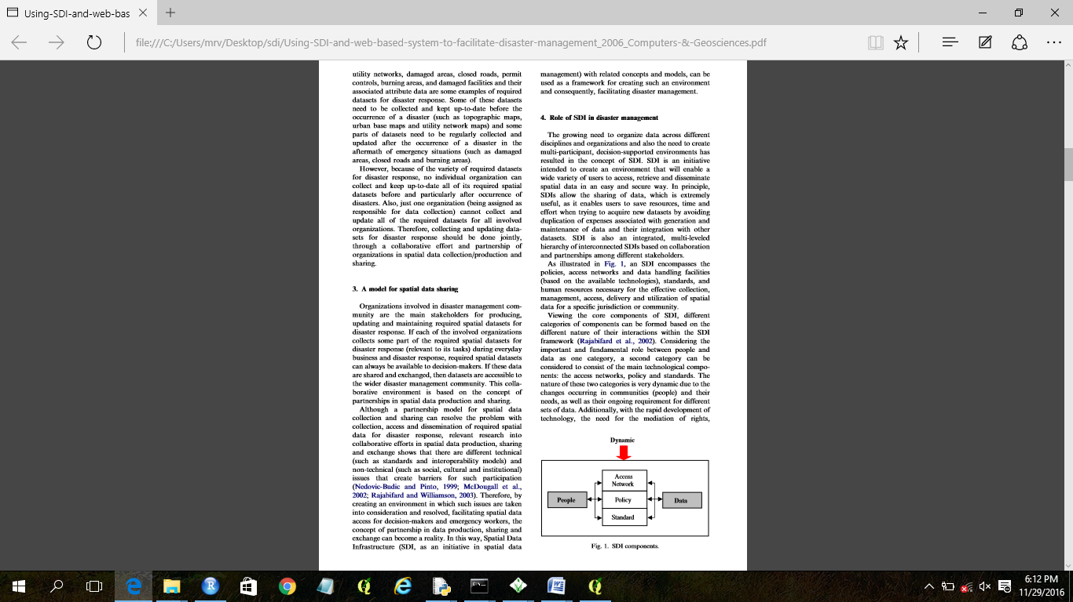
What is proposed to improve the information situation?
-> introducing SDI
Network
Policy
Standard
People
Data
Notes:
SDI - partnerships in spatial data are proposed to improve the weak forest related information situation of the county.
The form of the partnerships can range from the informal to the highly formal.
The need for partnerships applies at the personal, institutional, local area, national, and global levels.
The center targets the formal partnership at the institutional level.

Slide 13
What is SDI
Spatial data infrastructure (SDI) is the well connected and functional assemblage of the required technology, policies, and people to enable the sharing and use of geographic information.
It should include all levels of organizations and individuals such as government agencies, nonproﬁt organizations, the academic community, and individuals.

Slide 14
Geospatial partnership – principle
keeping the objectives clear
ensuring overall responsibility is agreed by participants
making available adequate resources from the participating institutions
keeping the numbers of partners to the minimum possible, consistent with achieving the desired aims.
Notes:
The principle, the MRV center sets for establishing the spatial data partnership, includes

Slide 15
Who are the actors in SDI development?
users and producers of data
data producers
detailed data as a product or a service
low-resolution, small-scale, limited themes for large areas
product providers
software, hardware, and related systems;
service providers
system development, database development, operations support, and consulting services.
educational institutions (e.g. WGCF-NR)
a variety of geographic data and provide GIS-related services
Notes:
users and producers of detailed data, such as utilities users of small-scale, limited geographic data, such as street networks, statistical areas, and administrative units;
data producers who create detailed data as a product or a service;
data producers who create low-resolution, small-scale, limited themes for large areas;
product providers who offer software, hardware, and related systems; and
service providers who offer system development, database development, operations support, and consulting services.
Non-profit and educational institutions also create and use a variety of geographic data and provide GIS-related services. They cover the full spectrum of data content, resolution, and geographic coverage.
Depending on the organisation’s activities, data use may range from highresolution data over small areas, as in facility management, to low-resolution data over wide areas, as in regional or national environmental studies.
The final category of stakeholder is
the consumer or
end-user.

Slide 16
Spatial data sharing protocols (policies)
Distributed/autonomous suppliers
The management of the data should be done as close as possible to source. This ensures the accuracy and quality of the data.
Non threatening to mandates
Commercial and government stakeholders need to feel comfortable as active participants in the infrastructure. They should not feel threatened by infrastructure business models or policies.
Multiple levels of “buy-in”; low barrier to entry
Sustainable long term business models
with mirroring the data / database (using different institutions’ servers)
Notes:
Some of the issues that need to be considered in the development of the supportive policy/organisational environment are:
Distributed/autonomous suppliers
The management of the data should be done as close as possible to source. This ensures the accuracy and quality of the data.
Non threatening to mandates
Commercial and government stakeholders need to feel comfortable as active participants in the infrastructure. They should not feel threatened by infrastructure business models or policies.
Multiple levels of “buy-in”; low barrier to entry
The access component of the infrastructure must provide multiple levels of buyin from a low cost option with limited benefits, e.g. basic advertising of products and services, to higher cost options that offer increased benefits, e.g. distributed search connections to the supplier’s inventory. This allows suppliers to choose a level of participation that best meets their business and operational objectives. This is especially important in the early operation of the access component as many suppliers will want to “try” it out and hence may not be prepared to expend much effort until they see how it works.
Sustainable long term business models
The access component of an infrastructure must provide an environment that supports a variety of supplier business models. The development of a sustainable business model for the operation of the access component is critical to the long term success of the entire infrastructure.

Slide 17
Proposed activities
Secure high-level commitment from the government
Bring all relevant agencies to the table
Create a system to retain institutional memory
Capacity development
Notes:
Secure high-level commitment from the government
Commitment to college-minister level coordination and data integration had to be secured at a high level from authorities with the power to mobilize action and collaboration between ministries. This has to be in the form of a legal mandate, requiring ministries to share data and improve collaboration. Active support from the highest level is an important pre-condition to spur the development of a national forest related spatial data infrastructure.
Bring all relevant agencies to the table
Different organizations at national / regional and or project level collect data independently and use different land-use maps for decision-making, which results in overlapping jurisdiction and conflicting land-use decisions. Conflicts prevent agencies from carrying out their responsibilities efficiently and can lead to tension and mistrust between agencies. The country should work towards bringing relevant stakeholders to the table, including those agencies not directly governing the forest sector.
Hence, one of the first planned steps in developing the forest information system is to undergo an institutional mapping exercise where relevant stakeholders are identified and convened. These stakeholders should include those agencies that are not directly governing the forest sector but that are making decisions that affect land use. These stakeholders should be engaged early in the forest information system design process to help foster trust among the stakeholders and willingness to share data.
Retain institutional memory
Developing standard: A common struggle that governments have with sustaining the functioning of a forest information system is the retention of institutional memory. Staff attrition is a common occurrence and one that results in loss of institutional memory, which refers to the knowledge needed to operate and maintain any system. Systems that require more training of and expertise from staff are more at risk of running into difficulty when there is turnover. To address this, the MRV center planned to create a forum for designing a forest information system (standard) to reduce the amount of specialized knowledge—and hence the amount of training—needed to use, update and maintain the system.
Developing manuals: Additionally, some institutional memory can also take the form of a user manual rather than knowledge transfer from person to person, thereby also reducing the amount of training needed.
Capacity developement
State governments / zone administrations / community based MRV projects are a substantial resource for efficient and cost-effective data collection. With coordinated use of standard procedures and methods for data collection and sharing, sub-national monitoring can provide accurate, methodologically consistent data, which can then better inform policy decisions. To utilize this important source of data for national-level integration of data, more capacity building and training on a set protocol for forest data collection are needed and sub-national governments should be included in the planning and implementation of the system. Additionally, preprocessed satellite imagery should be distributed to lower level users to enable them to carry out their data collection and sharing responsibilities.

Slide 18
Assignment 1:
Consider the case of local level administration such as Town or District that you know to discuss the following issues:
What institutions exist in the administration area requiring any type of geographic information?
What are the major types of geographic information that they need for their activities?
Which institutions can be potentially responsible as collector/provider of information?
Which institutions can be grouped as user?
What are the potential sources of the geographic data?

Slide 20
Assignment (practical) 3
Create a metadata for three types of data of
(1) thematic data with geographic coordinate system (preferably national level - Ethiopia level);
(2) local level data with projected coordinate system;
(3) imagery/aerial photograph. The instructor can provide the students the sample data or they can use their own data.

Slide 21
Assignment (practical) 3
Create a metadata for three types of data of
(1) thematic data with geographic coordinate system (preferably national level - Ethiopia level);
(2) local level data with projected coordinate system;
(3) imagery/aerial photograph. The instructor can provide the students the sample data or they can use their own data.

Slide 22
Project work
Discuss the activities in group
All database and image processing activities should be done individually.
Every student's practical exercises are evaluated individually. There is no evaluation of group projects!
Every week your progress will be evaluated and marked
A student who skips any practical will not be allowed to take the final exam.
Notes:
There is no evaluation of group projects!

Slide 23
Thematic data with geographic coordinate system (Region level)
Create a geo-database (Personal geo-database and Enterprise Geo-database) using EPSG 4201
Create a road layer - line
Lakes layer - polygon
Towns layer (Capital, regional, zonal administration) - point

Slide 24
Local level data with projected coordinate system
Create a geo-database (Personal geo-database and Enterprise Geo-database) for a district; create
Road layer
Stream layer
Land cover layer
Institutions

Slide 25
Image pre-processing
Select satellite image that covers your district. Its temporal coverage should be during the dry period of 2023 and 2024
Preprocess the image:
Layer stacking
Clip the image using the district’s boundary
Copy the metadata into your directory where the pre-processed the image is saved

